Slide 1
SOEN 423
Distributed Systems
Multithreading & Synchronization
Tutorial 1
Shivaraj Mallikarjun Alagond

Slide 2
About Me
Shivaraj Alagond
Graduate Student from Applied Computer Science
Email: shivaraj.alagond@gmail.com
Credits: Akriti Saini

Slide 3
Process Vs Thread
Process
Program in execution
Synonymous with Program or Application
Threads
Component of process
It’s lightweight process
Many threads can exist within the same process

Slide 4
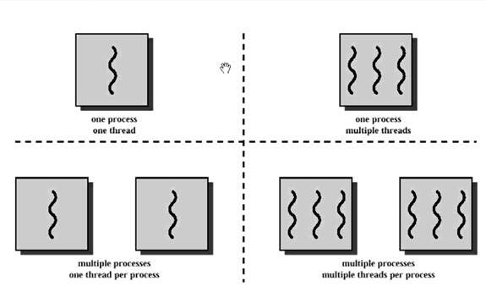
Continued …

Slide 5
Multithreading in General
Multi-tasking is the sharing of computer resources among a number of processes or the execution of a number of different processes at the same time (i.e. working on Eclipse while Chrome is running).
Multi-threading is the execution of a number of different tasks within the same process (i.e. sentence checking in MS Word while you are writing simultaneously).
They are allocated CPU time via context switching in such a way that they appear to be executing in parallel (i.e. except when there are actually multiple cores to deal with them separately, however it’s possible they are still executed on the same core).

Slide 6
Advantages of Multi-threading
Increased performance
Better utilization of resources (Ex. multiple core)
Handle multiple instances of data simultaneously

Slide 7
Disadvantages of Multi-threading
Added complexity to maintain multiple threads
Maintaining the shared resources(figure out a way to make sharing
between threads as efficient and as safe as possible)

Slide 8
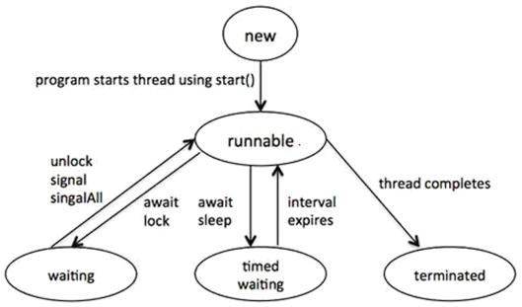
Thread Life-Cycle

Slide 9
Stages Explained
New: A new thread begins its life cycle in the new state. It remains in this state until the program starts the thread
Runnable: After a newly born thread is started, the thread becomes runnable.
Waiting: Transitions to waiting state while thread waits for another thread complete its task.
Timed waiting: A runnable thread can enter the timed waiting state for a specified interval of time.
Terminated: A runnable thread enters the terminated state when it completes its task or otherwise terminates

Slide 10
Multithreading in Java
Three ways to multithread in Java
Extending the Thread Class
Implementing the Runnable Interface
Using anonymous Thread Class

Slide 11
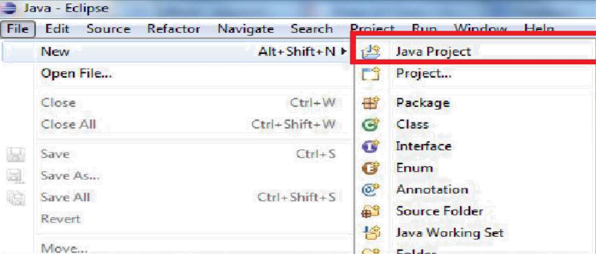
1.Extending the Thread Class:
1.Create the Project

Slide 12
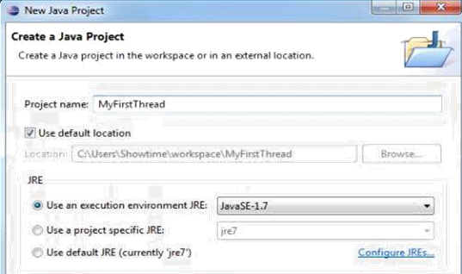
Extending the Thread Class (Cont.):
2. Project Name: MyFirstThread
3. Click on finish

Slide 13
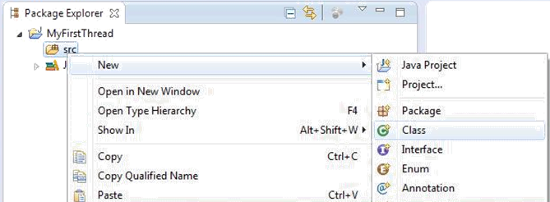
Extending the Thread Class (Cont.):
3. Expand the Project folder
4. Right click on src
6. Create new class named “HelloThread”

Slide 14
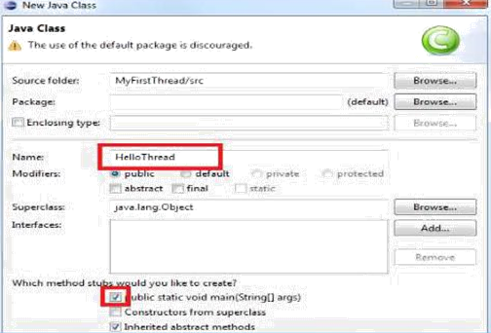
Extending the Thread Class (Cont.):
7. Check the “public static void main(String[] args)
8. Click on finish

Slide 15
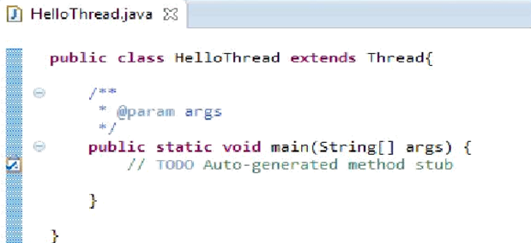
Extending the Thread Class (Cont.):
9. Extends thread

Slide 16
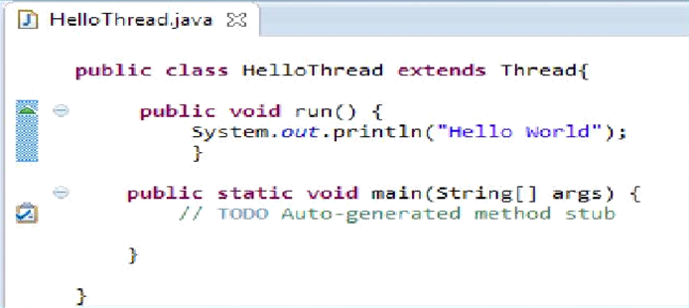
Extending the Thread Class (Cont.):
9. Override run() method:

Slide 17
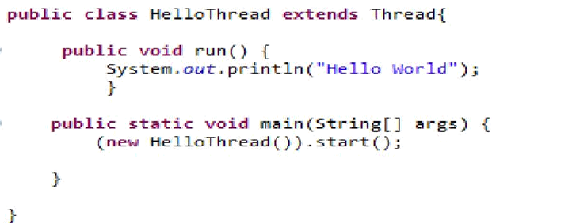
Extending the Thread Class (Cont.):
9. Create and start thread:

Slide 18
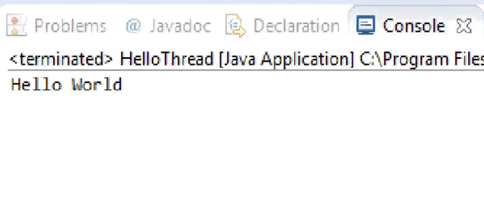
Extending the Thread Class (Cont.):
12. Run the program and the output should look like this:

Slide 19
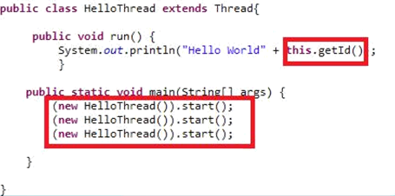
Extending the Thread Class (Cont.):
12. Examine the multi threads with this.getId() that returns unique thread identifier

Slide 20
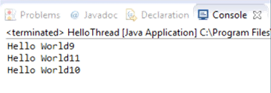

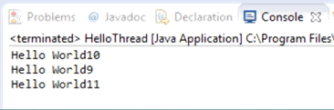
Extending the Thread Class (Cont.):
WHY???

Slide 21

2. Using the Runnable Interface
Create a new class file “HelloThread2”, in the same project

Slide 22
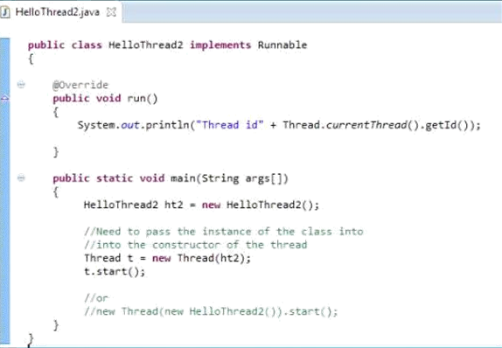
Code:

Slide 23
Difference between extends Thread and Implements Runnable Interface?

Slide 24
When you extend Thread class, you can’t extend any other class which you require. (As you know, Java does not allow inheriting more than one class). When you implement Runnable, you can save a space for your class to extend any other class in future or now.
When you extends Thread class, each of your thread creates unique object and associate with it. When you implements Runnable, it shares the same object to multiple threads.

Slide 25
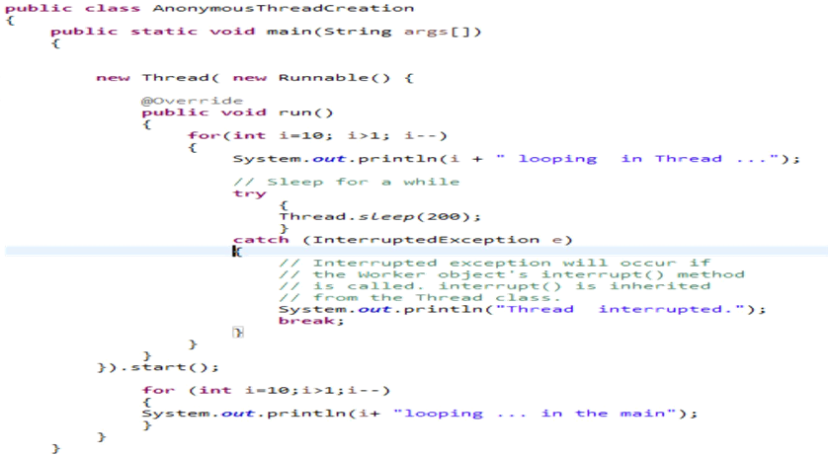
3. Thread creation using Anonymous creation
Directly creating a thread when we need it using new Thread()

Slide 26

Synchronization
In the Same package , create a new class name it SynchronizedCounter

Slide 27

Synchronization
Add Few Methods to the class :

Slide 28
Now imagine the following scenario:
Suppose you create 2 Threads (A and B)
A increments the counter
B decrements the counter
They execute:
1.Thread A: Retrieve c.
2.Thread B: Retrieve c.
3.Thread A: Increment retrieved value; result is 1.
4.Thread B: Decrement retrieved value; result is -1.
5.Thread A: Store result in c; c is now 1.
6.Thread B: Store result in c; c is now -1.

Slide 29
Problems in the above code
As one thread is incrementing the value and other thread is decrementing the value hence the resultant value of c should be 0
But in this case the value of the c is -1
Hence to overcome this problem we can use the Synchronized functions or the Synchronized blocks

Slide 30
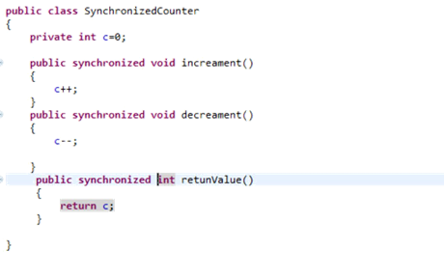
Synchronized
Method level synchronization

Slide 31
Synchronized
With the use of Synchronized variable the JVM allows only one Thread to enter the Synchronized regions so the problem that we experienced before can be emitted using the Synchronized block, methods (whichever you seem fit you can use)

Slide 32
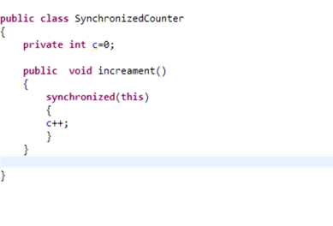
Synchronized
Block level synchronization

Slide 33
http://stackoverflow.com/questions/4394976/what-is-the-differencebetweensynchronizedthis-and-synchronizedmethod
http://www.geeksforgeeks.org/method-block-synchronization-java/

Slide 34
Thank You…

